Slide 1
Lecture 04
Inspiration and problem definition protocol

Slide 2
Inspiration and problem definition protocol
Write down your idea (2)
Make an abstract 8-up storyboard (10)
Share your work with others: 2 minutes for each idea (10)
Discuss each idea, build on each other: keep/throw it (10)
Finalize one idea (1)
Define users (5)
Identify classes (15)
Make sketches and storyboards (20)
Notes:
We stick to the protocol, no matter if some groups are able to complete it or not. They may complete it later and submit in the next class.

Slide 3
1 - Write down your idea on Paper
It must be a problem description, it should not be a solution to the mentioned problem

Slide 4
2 - Draw an 8-up storyboard
Fold a paper in half three times
Use each box to represent one step
The sketches need not be neat and clean
Just do a dirty quick prototype of your problem
Notes:
I'm also not that good at drawing, so my sketches are very crude. But that's the point! Low-fidelity prototypes, such as sketches should be simple and easy to replicate, as well as translate and flow ideas easily into the audience.

Slide 5
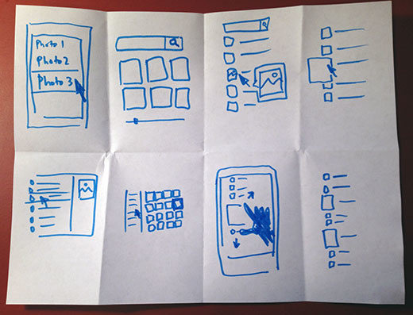
A Storyboard

Slide 6
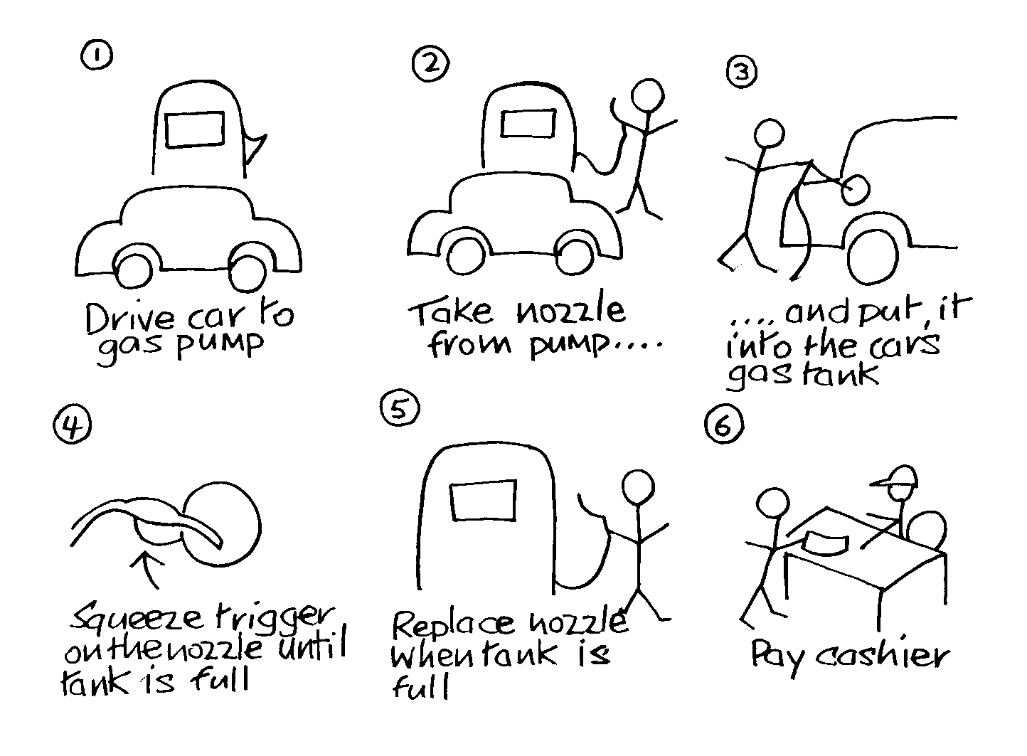
A Storyboard

Slide 7
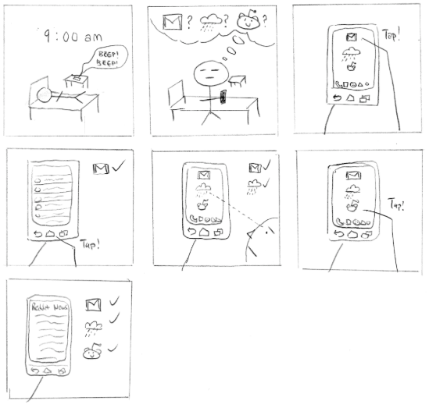
A Storyboard
Notes:
The first storyboard shows a stick figure waking up by it's alarm clock. His goal is to navigate across the three application and widget that he routinely visits every time in the morning. I don't think I see any problem at all here

Slide 8
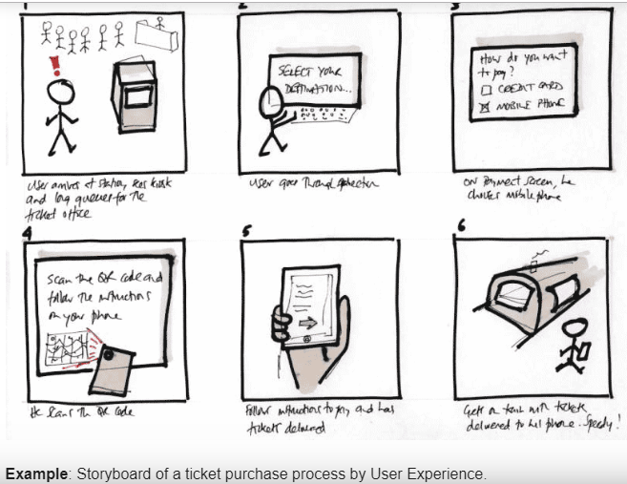
A Storyboard

Slide 9
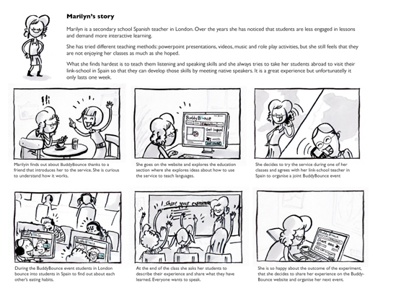
A Storyboard

Slide 10
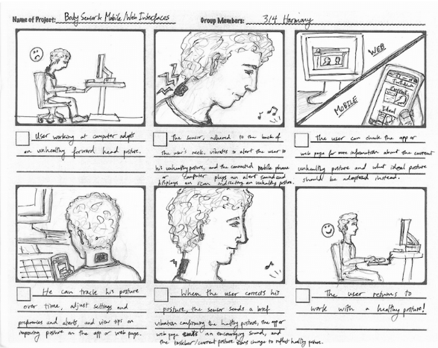
A Storyboard

Slide 11
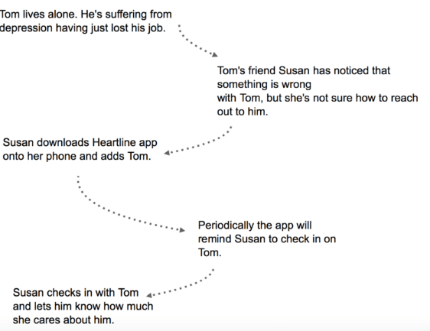
A Story board
Grab a pen and paper.
Start with a plain text and arrows.
Use proper nouns. (No common Nouns)

Slide 12
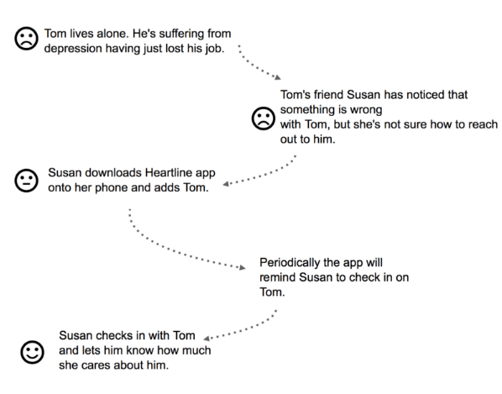
A Story board
Bake emotions into
the story.

Slide 13

A Story board
Translate each step into a frame.
You can leave a comment on the back of each frame to give more context.
You can also show a character’s thinking with thought bubbles
Notes:
Story board is scenario based and is in sequence. Sketching is mostly used for designing user interface , it is stand alone and not part of a series. It contains all possible details.

Slide 14
Some example problems
Finding the glasses
Finding a particular blood-group donner in another city

Slide 15
3 - Share your work with others
2 minutes for each idea
Is it novel
How it is being done now?

Slide 16
4 - Discuss each idea
build on each other: keep/throw it
You can also come up with new ideas
all ideas are equal
record everything
minimize interruptions & stay focused on topic
make it fun/rewarding
wild & wacky ideas are encouraged

Slide 17
5 - Finalize one idea
Get your group’s opinion about it
Give positive and negative feedback
Give possible suggestions and recommendations
Provide attributes for acceptance and rejection.

Slide 18
6 - Define Target Market
Discuss with each other
Shall be all-inclusive
Shall exclude areas which are not desired

Slide 19
7- Identify classes
Discuss with each other
Identify User Classes
Be careful while identifying the classes, don’t include unnecessary classes

Slide 20
8- Make sketches and storyboards
Brainstorm and gradually build the idea
Write story boards and make sketches for the finalized idea

Slide 21
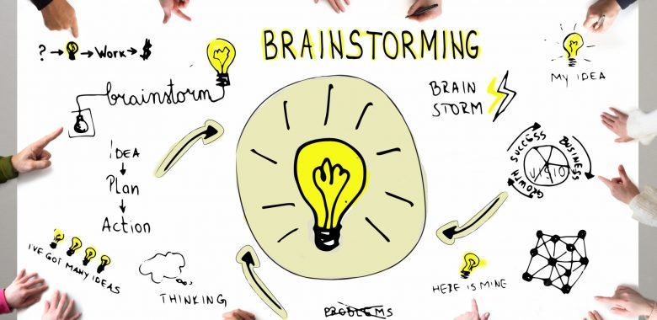
What we just did is Brainstorming
Brainstorming
  any group activity involving the pursuit of new ideas
  a technique used to generate numerous ideas using the composite talent and experience of a group in a facilitated meeting environment.

Slide 22
What we just did is Brainstorming
When it is Needed?
  increase the volume of possible ideas
  used for many things including
    names for products
    features for the next release of a product,
    possible solutions to difficult situations & issues
    goal generation for the team

Slide 23
What we just did is Brainstorming
Participants Needed
  A facilitator
  Several participants - normally 3 or more

Slide 24
What we just did is Brainstorming
Some rules of brainstorming
  all ideas are equal
  record everything
  minimize interruptions & stay focused on topic
  make it fun/rewarding
  wild & wacky ideas are encouraged
  build on the ideas of others
  one conversation at a time
  be visual

Slide 25
Assignment 01
The report includes
Title page
Group members, mention leader separately
Competing ideas and 8-up storyboards
Selected idea
Target Market
User classes
Brainstorming work
Sketches

